Slide 1
Unit 3 # IT Components (Lecture 8)

Slide 2
Telecommunication and Data Networks
Telecommunication Systems:
A telecommunications system is a collection of nodes and links to enable telecommunication.
Telecommunication is communication at a distance using electrical signals or electromagnetic waves.
The nodes in the system are the devices we use to communicate with, such as a telephone or a computer.

Slide 3
Components of Telecommunication
Hardware: All types of computers (desktop, server, mainframe) and communication processors.
Communication Media: The physical media through which electronic symbols are transmitted, including wireless media .
Communication Networks: The links among computers and communication devices.
Communication Software: Software that controls the telecommunication systems and entire transmission process.

Slide 4
5. Data Communication Providers: Regulated utilities or private firms that provides data communication services.
6. Communication Protocols: The rules for transmitting information across the system.
7. Communication Applications: Electronic data interchange, teleconferencing, video conferencing, e-mails, electronic fund transfer etc.

Slide 5
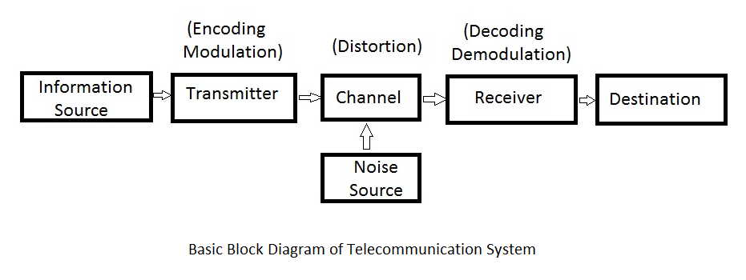

Slide 6
Data Networks
A data network is a system designed to transfer data from one network access point to one other or more network access points via data switching, transmission lines, and system controls.
Data networks consist of communication systems such as circuit switches, leased lines, and packet switching networks.
Data networks and data networking solutions impact nearly all modern day communication, such as telecommunications and the Internet.

Slide 7
Signals are typically transmitted via three main methodologies:
circuit switching: Before two nodes communicate, they establish a dedicated communications channel through the network.
message switching: Each message is routed in its entirety from switch to switch; at each switch, the message is stored and the information is read before being transmitted to the next switch.
packet switching: Messages are broken down and information is grouped into packets; each packet is transmitted over a digital network via the most optimum route to ensure minimal lag in data network speed, then the message is reassembled at the destinations.

Slide 8
Applications of Communication & Computer Network
Resource sharing such as printers and storage devices.
Exchange of information by means of e-Mails and FTP.
Information sharing by using Web or Internet.
Interaction with other users using dynamic web pages.
IP phones.
Video conferences.
Parallel computing.
Instant message

Slide 9
Network Types
1. Local Area Networks (LAN):
Local area networks, generally called LANs, are privately-owned networks within a single building or campus of up to a few kilometers in size.
They are widely used to connect personal computers and workstations in company offices and organizations to share resources (e.g., printers) and exchange information.
LANs are distinguished from other kinds of networks by three
characteristics:
(1) Their size,
(2) Their transmission technology
(3) Their topology.

Slide 10
LANs are restricted in size, which means that the worst-case transmission time is bounded and known in advance.
It also simplifies network management. Traditional LANs run at speeds of 10 Mbps to 100 Mbps, have low delay (microseconds or nanoseconds), and make very few errors.
Newer LANs operate at up to 10 Gbps.

Slide 11
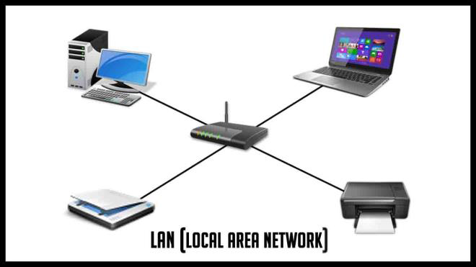

Slide 12
Characteristics of LAN:
• LANs are private networks, not subject to external control
• Simple and better performance
• Work in a restricted geographical area
Advantages:
• Resource sharing
• Software applications sharing
• Easy and Cheap communication
• Data Security
• Internet sharing
Disadvantages
• Restricted to local area

Slide 13
2.Metropolitan Area Network (MAN):
A metropolitan area network, or MAN, covers a city.
A MAN is a computer network that interconnects users with computer resources in a geographical area or region larger than that covered by a LAN.
It can be an interconnection between several LANs by bridging them with backbone lines.
The best-known example of a MAN is the cable television network available in many cities.
Recent developments in high-speed wireless Internet access resulted in another MAN, which has been standardized as IEEE 802.16.

Slide 14
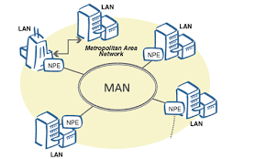
Fig: MAN

Slide 15
Characteristics:
• Generally, covers towns and cities (up to 50km)
• Transmission medium used for MAN is optical fiber, coaxial cable etc.
• Data rates adequate for distributed computing applications
Advantages
• Extremely efficient and provide fast communication via high-speed carriers, such as fiber optic cables
• Good backbone for larger networks and provides greater access to WAN
Disadvantages
• Complex, more cabling required and expensive

Slide 16
3.Wide Area Network (WAN):
A wide area network, or WAN, spans a large geographical area, often a country or continent.
It contains a collection of machines intended for running user (i.e., application) programs.
These machines are called as hosts.
The hosts are connected by a communication subnet, or just subnet for short.
WANs are typically used to connect two or more LANs or MANs which are located relatively far from each other
In most WANs, the network contains numerous transmission lines, each one connecting a pair of routers.

Slide 17
Characteristics
• Covers large distances (states, countries, continents)
• Communication medium used are satellite, public telephone networks which are connected by routers
Advantages
• Covers large geographical area
• Shares software and resources with connecting workstations
• Information can be exchanged to anyone else worldwide in the network
Disadvantages
• Data security
• Network is very complex and management is difficult
• As size increases, the networks becomes more expensive

Slide 18
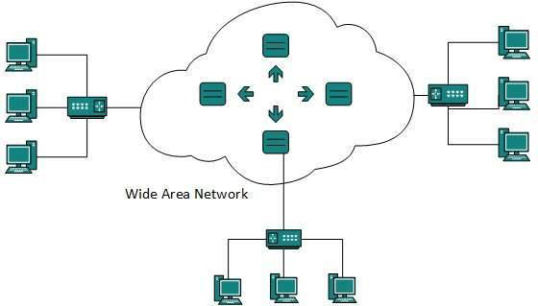
Fig: WAN

Slide 19
PHYSICAL TOPOLOGY:
The term physical topology refers to the way in which a network is laid out physically.
One or more devices connect to a link; two or more links form a topology.
The topology of a network is the geometric representation of the relationship of all the links and linking devices (usually called nodes) to one another.
There are four basic topologies possible: mesh, star, bus, and ring.

Slide 20
1. BUS:
A bus topology is multipoint. One long cable act as a backbone to link all the devices in a network.
Nodes are connected to the bus cable by drop lines and taps. A drop line is a connection running between the device and the main cable.
A tap is a connector that either splices into the main cable or punctures the sheathing of a cable to create a contact with the metallic core.
As a signal travels along the backbone, some of its energy is transformed into heat.
Therefore, it becomes weaker and weaker as it travels farther and farther.
For this reason, there is a limit on the number of taps a bus can support and on the distance between those taps.

Slide 21
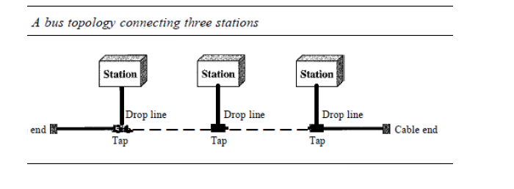

Slide 22
Advantages:
ease of installation.
a bus uses less cabling than mesh or star topologies.
Disadvantages:
difficult reconnection and fault isolation.
difficult to add new devices.
signal reflection at the taps can cause degradation in quality

Slide 23
2. Star Topology:
In a star topology, each device has a dedicated point-to-point link only to a central controller, usually called a hub.
The devices are not directly linked to one another.
Unlike a mesh topology, a star topology does not allow direct traffic between devices.
The controller acts as an exchange: If one device wants to send data to another, it sends the data to the controller, which then relays the data to the other connected device.

Slide 24
Advantages
each device needs only one link and one I/O port to connect it to any number of others.
Easy to install and reconfigure.
robustness.
Disadvantages:
the dependency of the whole topology on one single point, the hub.
more cabling is required

Slide 25
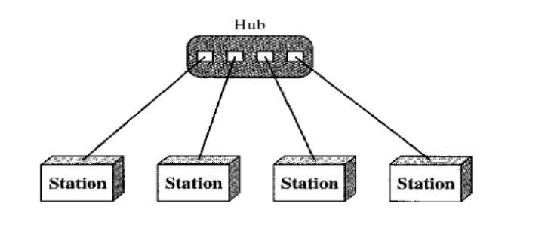
Figure: Star Topology

Slide 26
3. RING:
In a ring topology, each device has a dedicated point-to-point connection with only the two devices on either side of it.
A signal is passed along the ring in one direction, from device to device, until it reaches its destination.
Each device in the ring incorporates a repeater. When a device receives a signal intended for another device, its repeater regenerates the bits and passes them along.

Slide 27
Advantages:
easy to install and reconfigure. Each device is linked to only its immediate neighbors (either physically or logically).
to add or delete a device requires changing only two connections.
fault isolation is simplified.
Disadvantages:
Unidirectional traffic can be a disadvantage.
In a simple ring, a break in the ring (such as a disabled station) can disable the entire network.

Slide 28
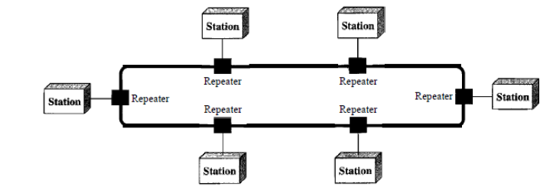
Figure: Ring Topology

Slide 29
Mesh Topology:
In a mesh topology, every device has a dedicated point-to-point link to every other device.
The term dedicated means that the link carries traffic only between the two devices it connects.
To find the number of physical links in a fully connected mesh network with n nodes, we first consider that each node must be connected to every other node. Node 1 must be connected to n - I nodes, node 2 must be connected to n – 1 node, and finally node n must be connected to n - 1 nodes.
We need n(n - 1) physical links. However, if each physical link allows communication in both directions (duplex mode), we can divide the number of links by 2.
In other words, we can say that in a mesh topology, we need n(n -1) /2 duplex-mode links..

Slide 30
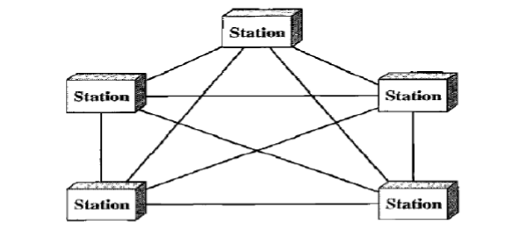
Figure: Mesh Topology

